Slide 1

50.051 Programming Language Concepts W5-S1 Reminders on Finite State Machines (FSMs)
Matthieu De Mari

Slide 2
Finite State Machine (as seen in DDW)
Definition (Finite State Machine):
A Finite State Machine (FSM), or finite automaton, is a mathematical model used to represent systems
that have a finite number of possible states,
and can transition between these states based on given inputs.
An FSM can be represented using a graph representation, known as a state diagram, which shows the possible states of the system and the transitions between them.
FSMs are used in a wide variety of applications (control systems, communication protocols, digital circuits, etc.). In our case, FSMs are at the center of the compiling process.

Slide 3
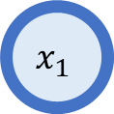
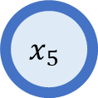
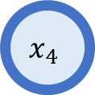
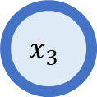
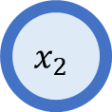
Graph theory
$$x_{2}$$
Definition (graph theory):
In mathematics, graph theory is the study of graphs objects, which are mathematical structures used to model pairwise relations between objects.
Graphs are one of the principal objects of study in discrete mathematics.
(Need a refresher? Check additional materials!)
$$x_{1}$$
$$x_{4}$$
$$x_{3}$$
$$x_{5}$$

Slide 4
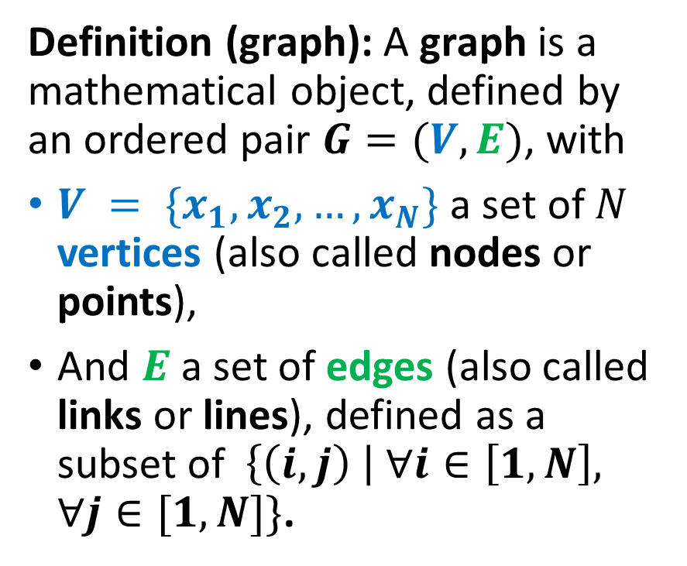
Graphs: a general and minimal definition
$$x_{2}$$
Definition (graph): A graph is a mathematical object, defined by an ordered pair $G=(V, E)$, with
$V = \{x_{1}, x_{2}, …, x_{N}\}$ a set of $N$ vertices (also called nodes or points),
And $E$ a set of edges (also called links or lines), defined as a subset of $\left\{\left(i,j\right) \right| ∀i∈\left[1,N\right], ∀j∈[1, N]\}$.
$$x_{1}$$
$$x_{4}$$
$$x_{3}$$
$$x_{5}$$

Slide 5
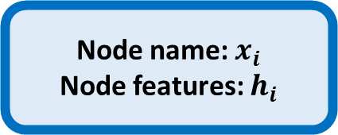
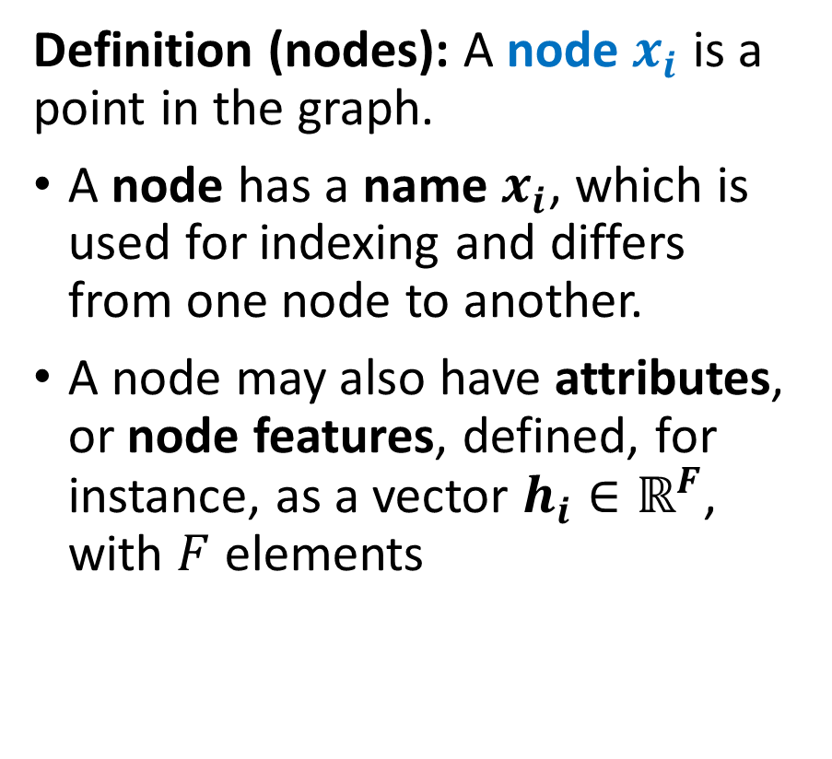
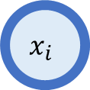
Nodes definition and attributes
$$x_{2}$$
Definition (nodes): A node $x_{i}$ is a point in the graph.
A node has a name $x_{i}$, which is used for indexing and differs from one node to another.
A node may also have attributes, or node features, defined, for instance, as a vector $h_{i}∈ℝ^{F}$, with $F$ elements
$$x_{1}$$
$$x_{4}$$
$$x_{3}$$
$$x_{5}$$
Node name: $x_{i}$
Node features: $h_{i}$
$$x_{i}$$

Slide 6

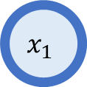


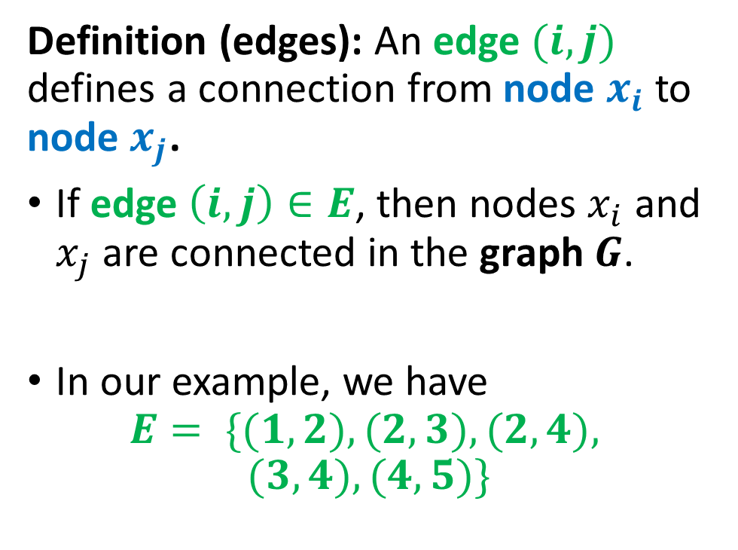
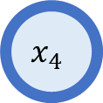

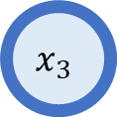



Edges definition
$$(1,2)$$
$$x_{2}$$
$$x_{1}$$
Definition (edges): An edge $(i,j)$ defines a connection from node $x_{i}$ to node $x_{j}$.
If edge $\left(i,j\right)∈E$, then nodes $x_{i}$ and $x_{j}$are connected in the graph $G$.
In our example, we have
$$E= \{(1,2), (2,3), (2,4),$$
$$(3,4), (4,5)\}$$
$$(2,4)$$
$$(2,3)$$
$$x_{4}$$
$$x_{3}$$
$$(3,4)$$
$$(4,5)$$
$$x_{5}$$

Slide 7
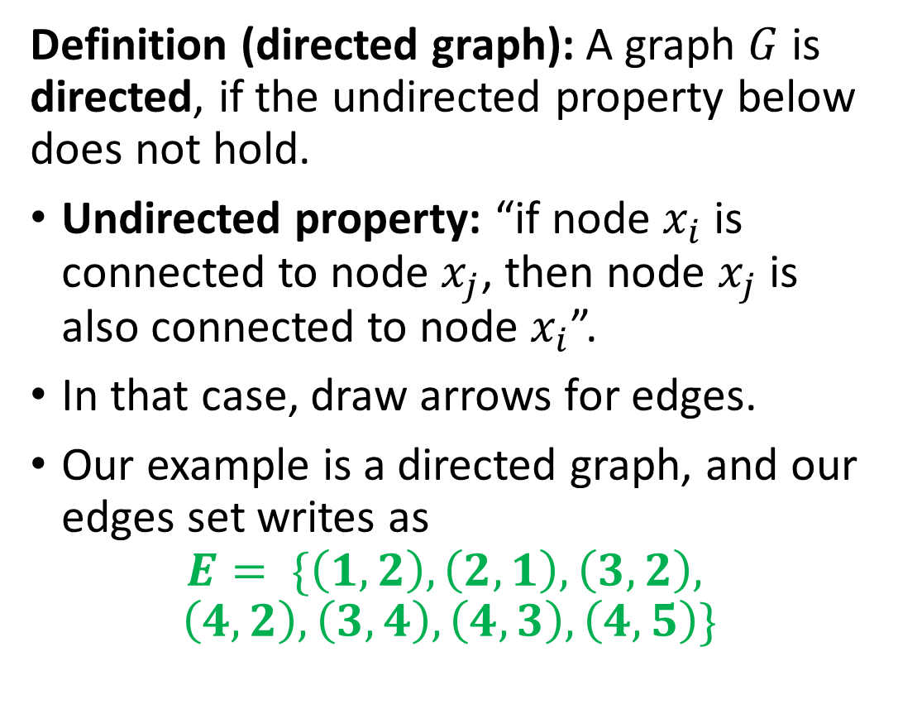
Directed graph definition
$$x_{2}$$
Definition (directed graph): A graph $G$ is directed, if the undirected property below does not hold.
Undirected property: “if node $x_{i}$ is connected to node $x_{j}$, then node $x_{j}$is also connected to node $x_{i}$”.
In that case, draw arrows for edges.
Our example is a directed graph, and our edges set writes as
$$E= \{\left(1,2\right), \left(2,1\right), \left(3,2\right),$$
$$\left(4,2\right), \left(3,4\right), \left(4,3\right), \left(4,5\right)\}$$
$$x_{1}$$
$$x_{4}$$
$$x_{3}$$
$$x_{5}$$

Slide 8


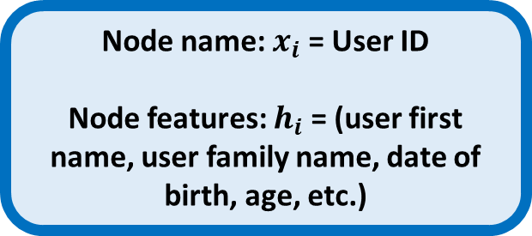
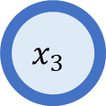
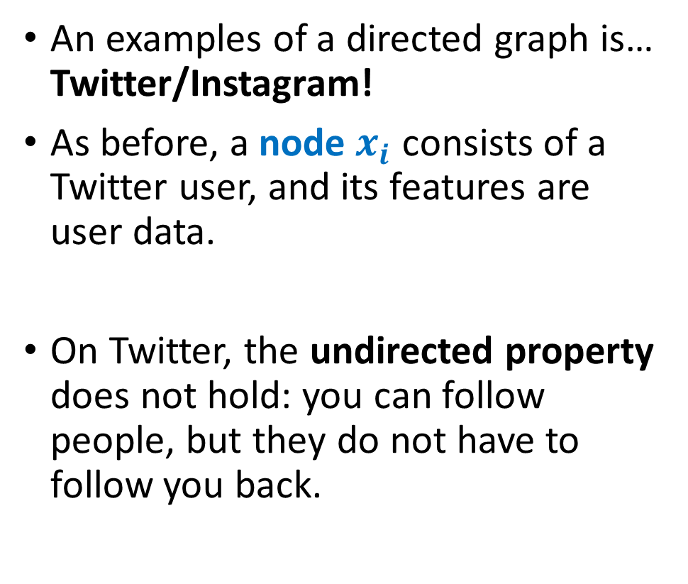
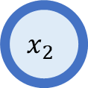

Examples of a directed graph
An examples of a directed graph is… Twitter/Instagram!
As before, a node $x_{i}$ consists of a Twitter user, and its features are user data.
On Twitter, the undirected property does not hold: you can follow people, but they do not have to follow you back.
Node name: $x_{i}$ = User ID
Node features: $h_{i}$ = (user first name, user family name, date of birth, age, etc.)
$$x_{2}$$
$$x_{1}$$
$$x_{3}$$

Slide 9
Back to our Finite State Machine
Definition (Finite State Machine):
A Finite State Machine (FSM), or finite automaton, is a mathematical model used to represent systems
that have a finite number of possible states,
and can transition between these states based on given inputs.
An FSM can be represented using a graph representation, known as a state diagram, which shows the possible states of the system and the transitions between them.
FSMs are used in a wide variety of applications (control systems, communication protocols, digital circuits, etc.). In our case, FSMs are at the center of the compiling process.

Slide 10
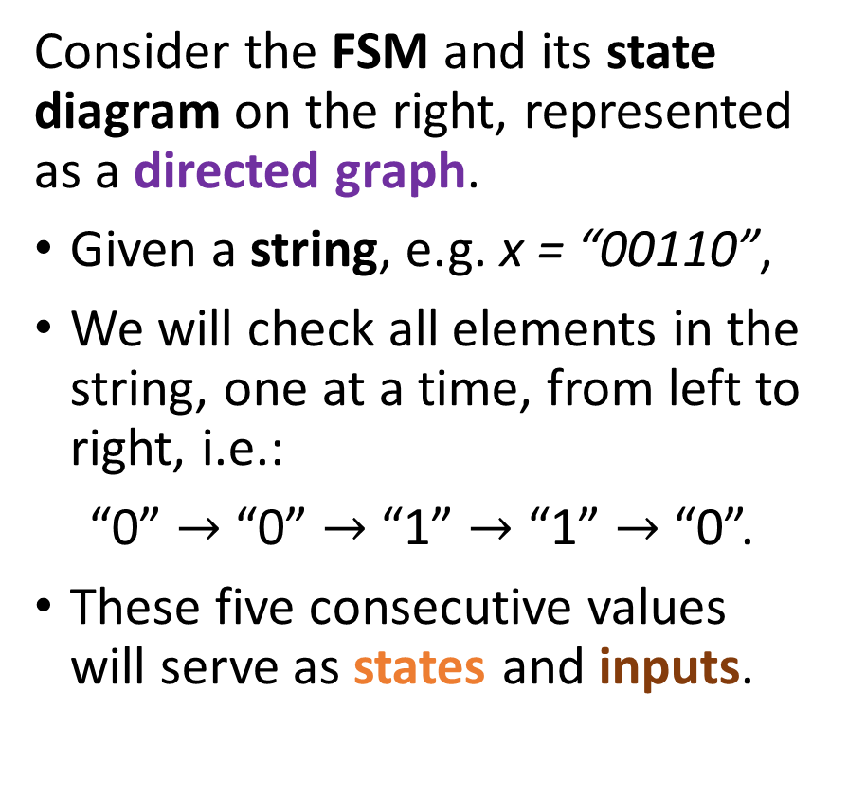
An example of an FSM
Consider the FSM and its state diagram on the right, represented as a directed graph.
Given a string, e.g. x = “00110”,
We will check all elements in the string, one at a time, from left to right, i.e.:
“0” $→$ “0” $→$ “1” $→$ “1” $→$ “0”.
These five consecutive values will serve as states and inputs.
Start
0
1

Slide 11
An example of an FSM
Consider the FSM and its state diagram on the right, represented as a directed graph.
Begin at start node, which is defined as a node, receiving an incoming arrow with no source.
Start
0
1

Slide 12
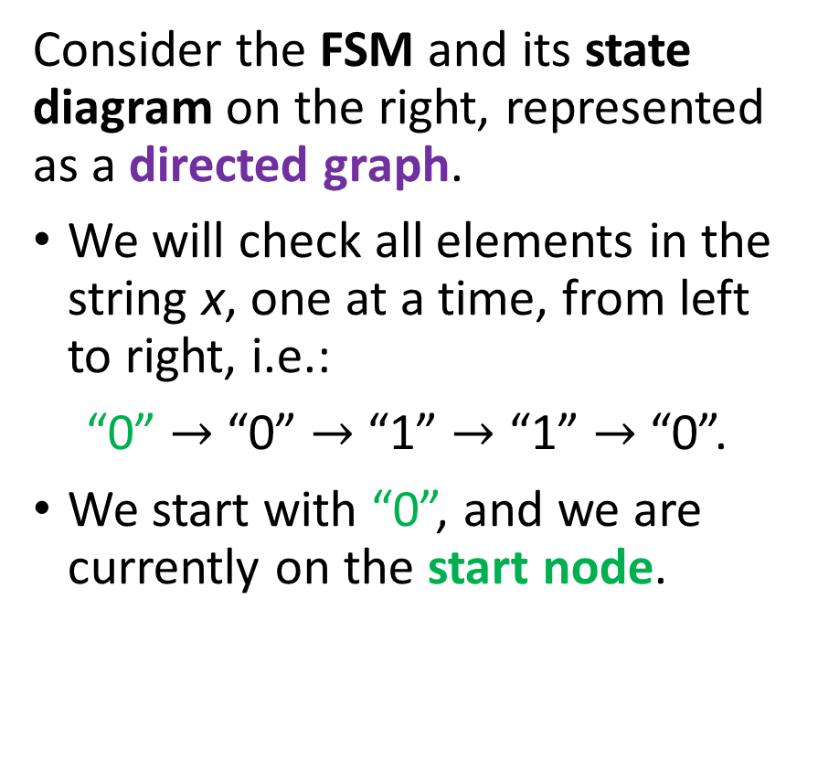
An example of an FSM
Consider the FSM and its state diagram on the right, represented as a directed graph.
We will check all elements in the string x, one at a time, from left to right, i.e.:
“0” $→$ “0” $→$ “1” $→$ “1” $→$ “0”.
We start with “0”, and we are currently on the start node.
Start
0
1

Slide 13
An example of an FSM
And then, move in the FSM state diagram, following a logic.
We first consider that this value “0” serves as input (or action) for this turn.
Logic, defined by the directed graph, for this FSM (could differ from one FSM to another):
“On every input, your next state will be matching your input. See 0 as input, move to state 0. And vice-versa.”
Start
0
1
0
1

Slide 14
An example of an FSM
For instance,
Following this logic, our first turn sees the input value “0”.
Moves from our current state, the start node,
To the next state, i.e. node “0”,
Following the directed edge, starting from the start node and labelled with “0”.
Start
0
1
0
1

Slide 15
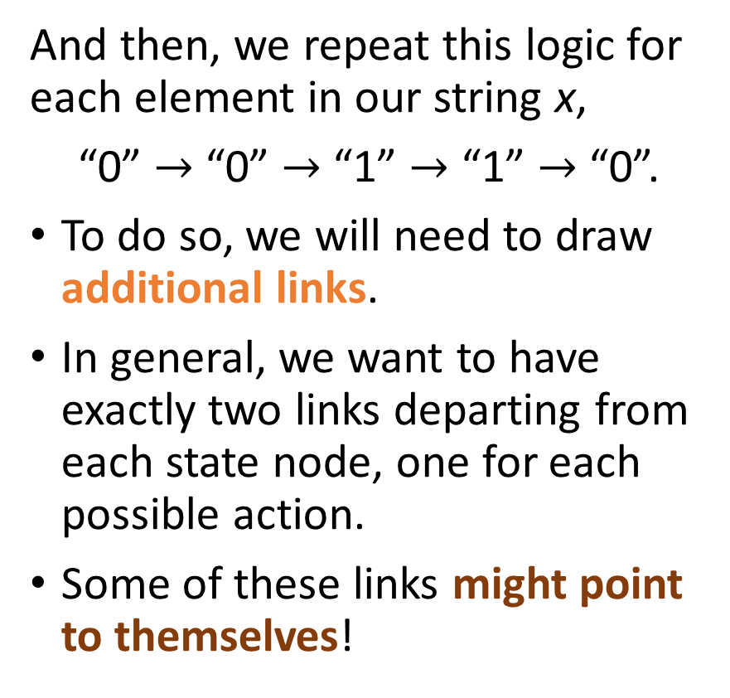
An example of an FSM
And then, we repeat this logic for each element in our string x,
“0” $→$ “0” $→$ “1” $→$ “1” $→$ “0”.
To do so, we will need to draw additional links.
In general, we want to have exactly two links departing from each state node, one for each possible action.
Some of these links might point to themselves!
Start
0
1
0
1
0
1
1
0

Slide 16
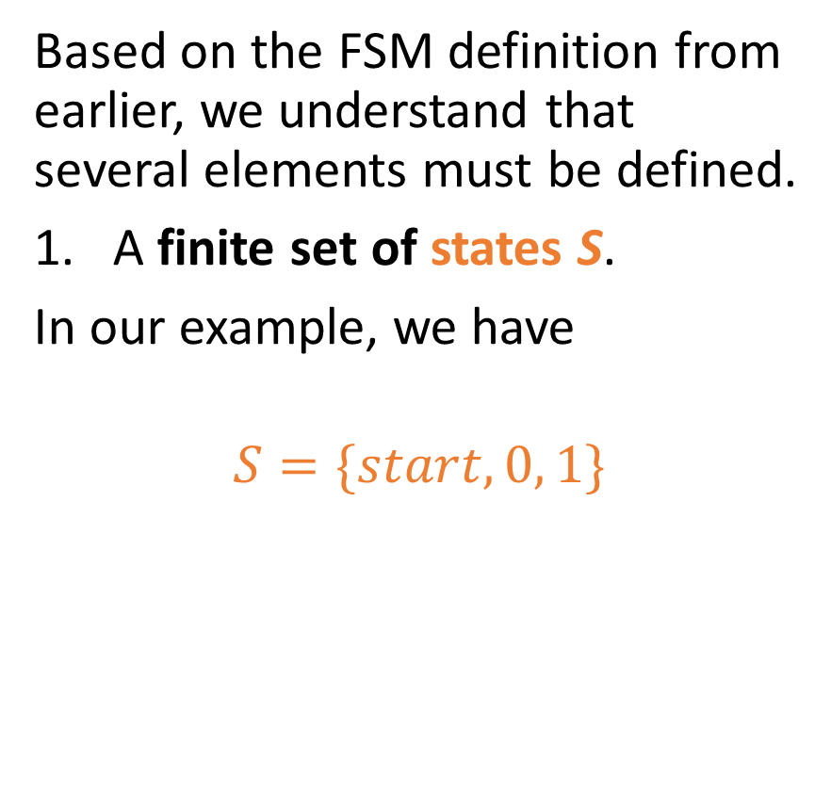
Elements of an FSM
Based on the FSM definition from earlier, we understand that several elements must be defined.
A finite set of states S.
In our example, we have
$$S=\{start, 0, 1\}$$
Start
0
1
0
1
0
1
1
0

Slide 17
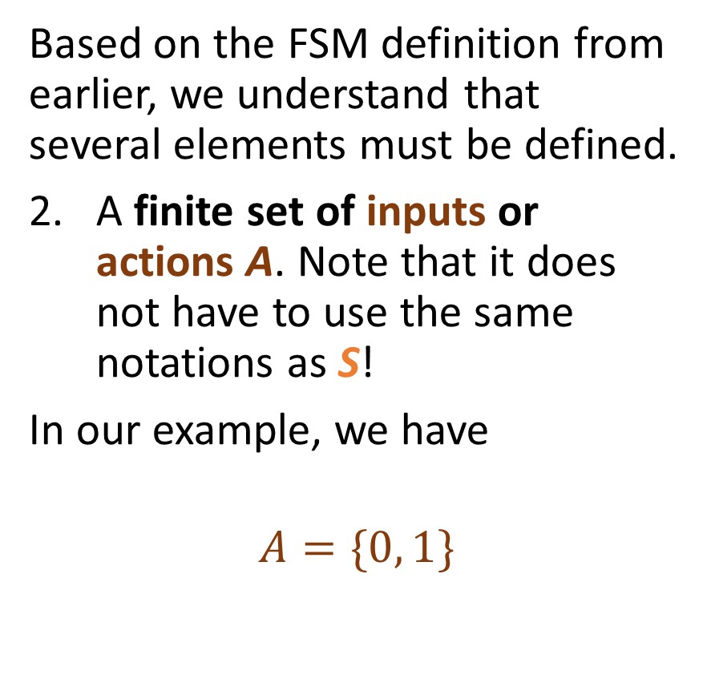
Elements of an FSM
Based on the FSM definition from earlier, we understand that several elements must be defined.
A finite set of inputs or actions A. Note that it does not have to use the same notations as S!
In our example, we have
$$A=\{0, 1\}$$
Start
0
1
0
1
0
1
1
0

Slide 18
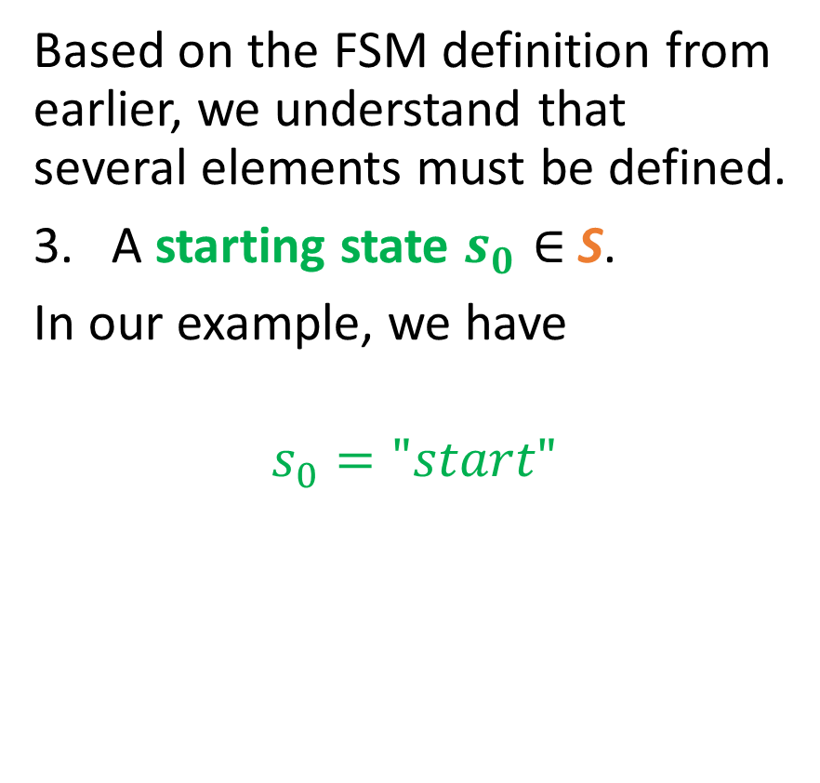
Elements of an FSM
Based on the FSM definition from earlier, we understand that several elements must be defined.
A starting state $s_{0}∈$S.
In our example, we have
$$s_{0}="start"$$
Start
0
1
0
1
0
1
1
0

Slide 19
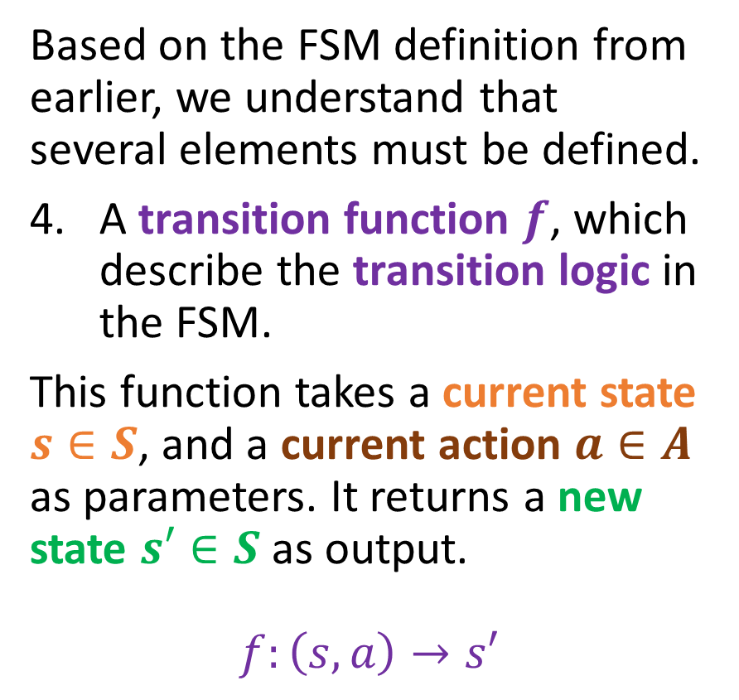
Elements of an FSM
Based on the FSM definition from earlier, we understand that several elements must be defined.
A transition function $f$, which describe the transition logic in the FSM.
This function takes a current state $s∈S$, and a current action $a∈A$ as parameters. It returns a new state $s′∈S$ as output.
$$f:\left(s, a\right)→s′$$
Start
0
1
0
1
0
1
1
0

Slide 20
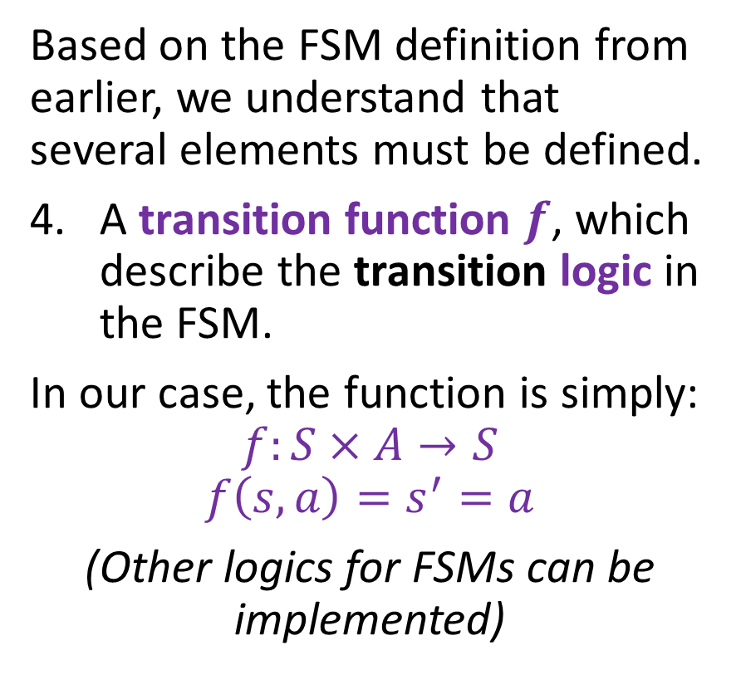
Elements of an FSM
Based on the FSM definition from earlier, we understand that several elements must be defined.
A transition function $f$, which describe the transition logic in the FSM.
In our case, the function is simply:
$$f:S×A→S$$
$$f\left(s,a\right)=s^{′}=a$$
(Other logics for FSMs can be implemented)
Start
0
1
0
1
0
1
1
0

Slide 21
Elements of an FSM
Note: the transition function can also be expressed in the form of a transition table, as shown below.
Start
Current state | Input | Next state
Start | 0 | 0
Start | 1 | 1
0 | 0 | 0
0 | 1 | 1
1 | 0 | 0
1 | 1 | 1
0
1
0
1
0
1
1
0

Slide 22
Adding a stopping state
Definition (stopping states or accepting states):
In a finite state machine (FSM), a stopping state or accepting state is a special type of state node in which the FSM can terminate.
Stopping states can be represented in the state transition diagram by drawing a double circle around the state.
0
1
0 is an accepting state
1 is not an accepting state

Slide 23
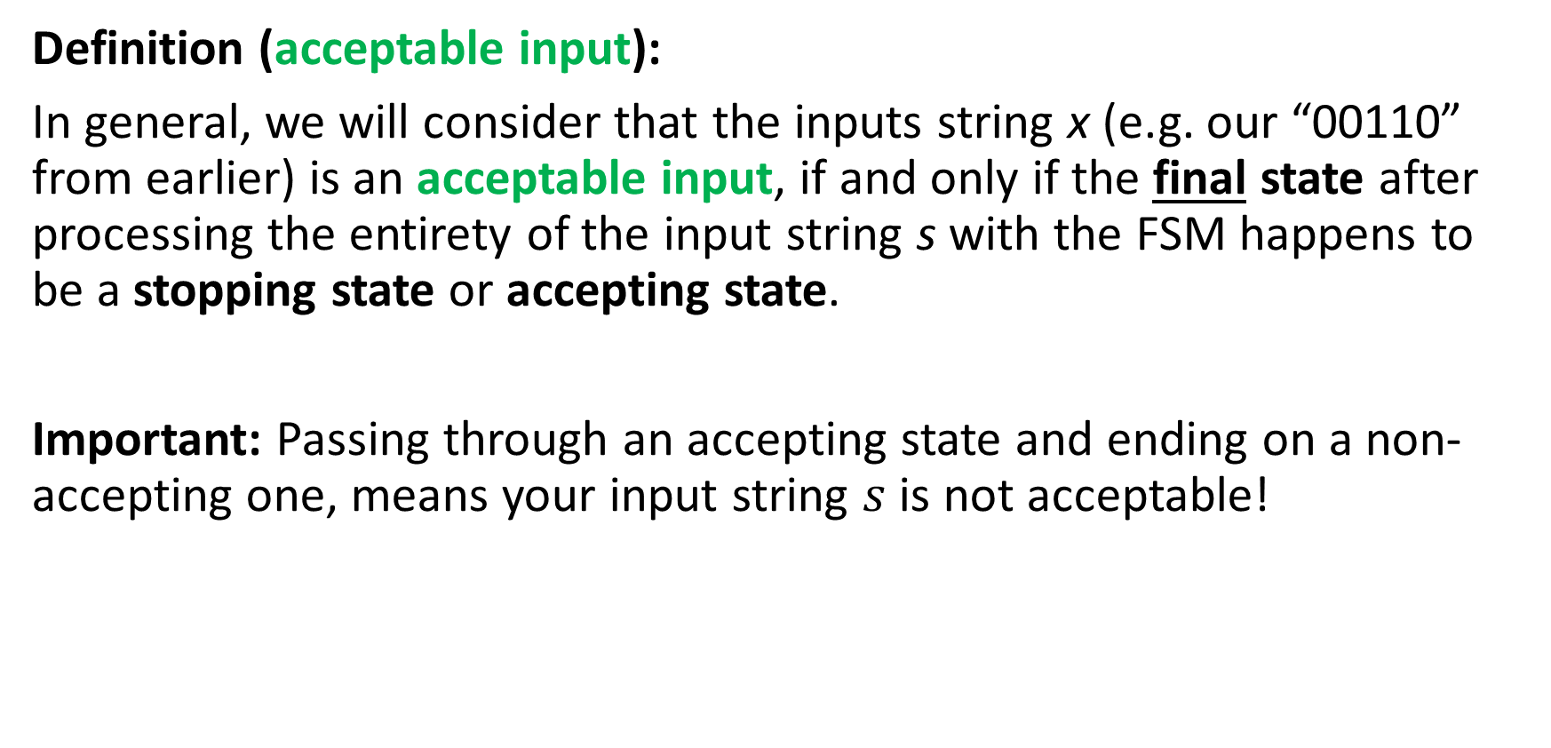
Adding a stopping state
Definition (acceptable input):
In general, we will consider that the inputs string x (e.g. our “00110” from earlier) is an acceptable input, if and only if the final state after processing the entirety of the input string s with the FSM happens to be a stopping state or accepting state.
Important: Passing through an accepting state and ending on a non-accepting one, means your input string $s$ is not acceptable!

Slide 24
Adding a stopping state
Stopping states can be represented in the state transition diagram by drawing a double circle around the state, or by adding a label to the state to indicate that it is a stopping state.
In our example, the state 0 is now a stopping state, but 1 and Start are not.
Start
0
1
0
1
0
1
1
0

Slide 25
Adding a stopping state
As we will see later through practice, an FSM with stopping states can be used to perform specific tasks, such as recognizing patterns or processing data.
Typically, in a language recognizer FSM, the stopping state will be used to indicate that the FSM has recognized a certain substring in the input string x.
Start
0
1
0
1
0
1
1
0

Slide 26
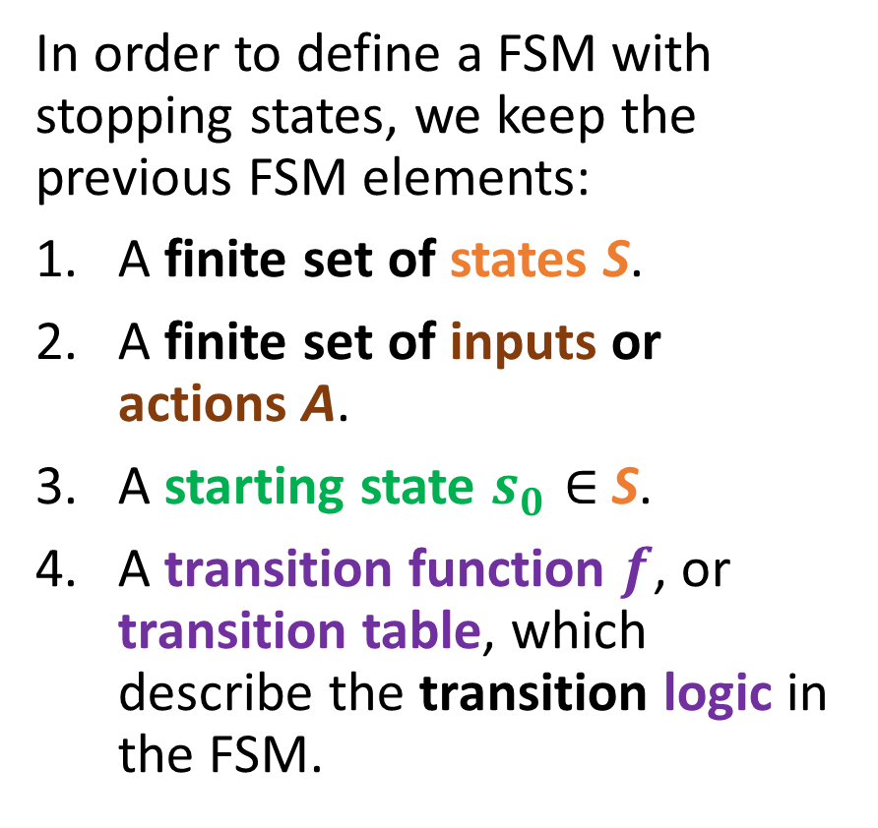
Elements of an FSM with stopping states
In order to define a FSM with stopping states, we keep the previous FSM elements:
A finite set of states S.
A finite set of inputs or actions A.
A starting state $s_{0}∈$S.
A transition function $f$, or transition table, which describe the transition logic in the FSM.
Start
0
1
0
1
0
1
1
0

Slide 27
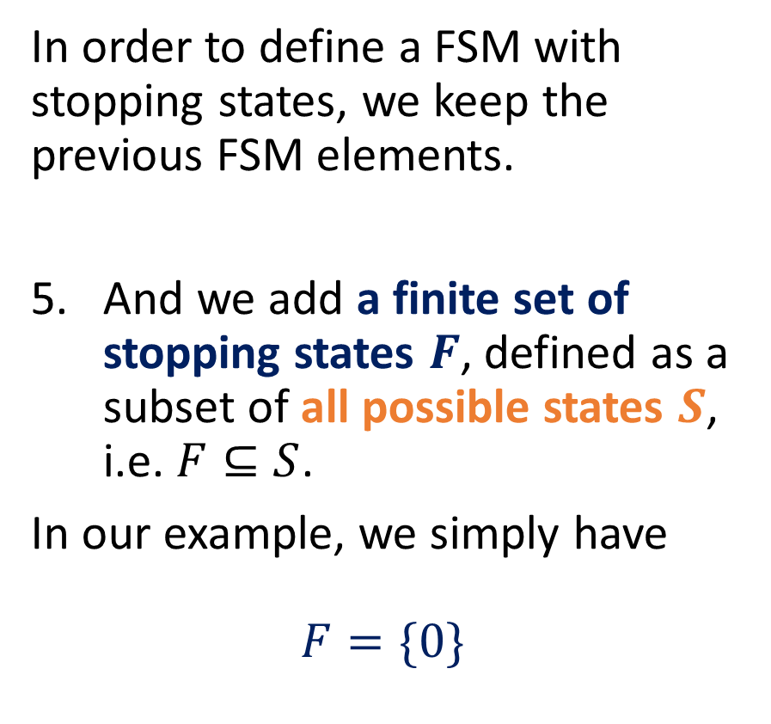
Elements of an FSM with stopping states
In order to define a FSM with stopping states, we keep the previous FSM elements.
And we add a finite set of stopping states $F$, defined as a subset of all possible states $S$, i.e. $F⊆S$.
In our example, we simply have
$$F=\{0\}$$
Start
0
1
0
1
0
1
1
0

Slide 28
Practice 1: Analysing our example FSM
Question 1: Looking at the FSM state diagram on the right, what are the acceptable inputs x that our FSM is checking?
Question 2: If the input strings are binary strings encoding an unsigned integer number, what numbers does this FSM consider as acceptable inputs?
Start
0
1
0
1
0
1
1
0

Slide 29
Practice 1: Analysing our example FSM
Question 1: Looking at the FSM state diagram on the right, what are the acceptable inputs x that our FSM is checking?
Answer: We need to end on a final state being 0. In our case, this means that an acceptable string s simply consists of any binary string that ends with 0.
Start
0
1
0
1
0
1
1
0

Slide 30
Practice 1: Analysing our example FSM
Question 2: If the input strings are binary strings encoding an unsigned integer number, what numbers does this FSM consider as acceptable inputs?
Answer: We need the bit of least importance to be 0. This means that the integer number input represented by the string s needs to be even to be acceptable.
Start
0
1
0
1
0
1
1
0

Slide 31
Practice 2: a simple FSM for word recognition
We would like to write an FSM with stopping states that will take strings x consisting of combinations of four characters: S, U, T and D.
Possible combinations for the string x include, among many others, “USD”, “SUUUUTD”, and the only acceptable input “SUTD”.
Draw a FSM state diagram, which:
Has 6 possible States (Start, S, U, T, D, Invalid),
Has 4 possible Actions (S, U, T, D),
Has the Start state defined as the starting state,
Has the D state defined as the only stopping state,
Has the FSM stop in this state D, if and only x is exactly “SUTD”; otherwise, it stops in another state (Invalid or something else).

Slide 32
Elements of an FSM with outputs
In general, outputs with stopping or accepting states are useful, but limited in terms of applications.
A stronger version of the FSM consists of the FSM with outputs.
It simply replaces the stopping states with outputs being produced every time an action is taken.
Start
0
1
0
1
0
1
1
0

Slide 33

Elements of an FSM with outputs
In order to define an FSM with outputs, we keep the previous FSM elements:
A finite set of states S.
A finite set of inputs or actions A.
A starting state $s_{0}∈$S.
A transition function $f$, or transition table, which describe the transition logic in the FSM.
Start
0
1
0
1
0
1
1
0

Slide 34
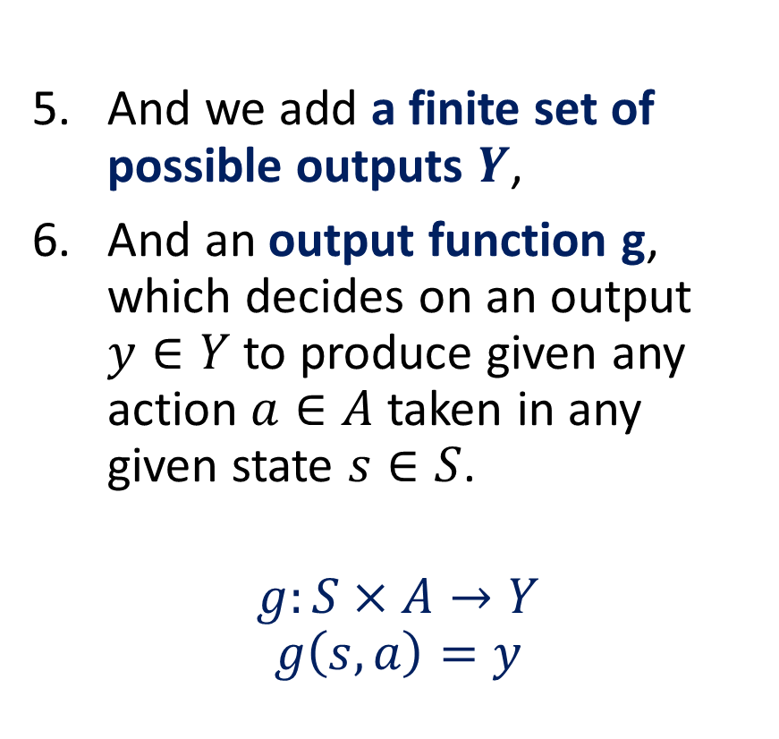
Elements of an FSM with outputs
And we add a finite set of possible outputs $Y$,
And an output function g, which decides on an output $y∈Y$ to produce given any action $a∈A$ taken in any given state $s∈S$.
$$g:S×A→Y$$
$$g\left(s,a\right)=y$$
Start
0
1
0
1
0
1
1
0

Slide 35
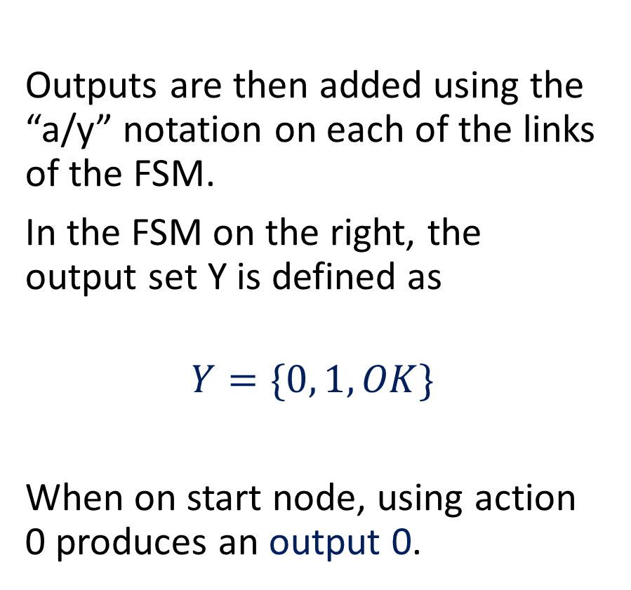
Elements of an FSM with outputs
Outputs are then added using the “a/y” notation on each of the links of the FSM.
In the FSM on the right, the output set Y is defined as
$$Y=\{0, 1, OK\}$$
When on start node, using action 0 produces an output 0.
Start
0/0
1/1
0/”OK”
1/1
0
1/1
1
0/0

Slide 36
Elements of an FSM with outputs
Could also define outputs in the form of a table of values to be produced if a given action a, is taken in a state s.
Similar to the transition table from earlier, which gave us the new state s’ if a given action a, is taken in a state s.
Start
0/0
1/1
0/”OK”
1/1
0
1/1
1
0/0

Slide 37
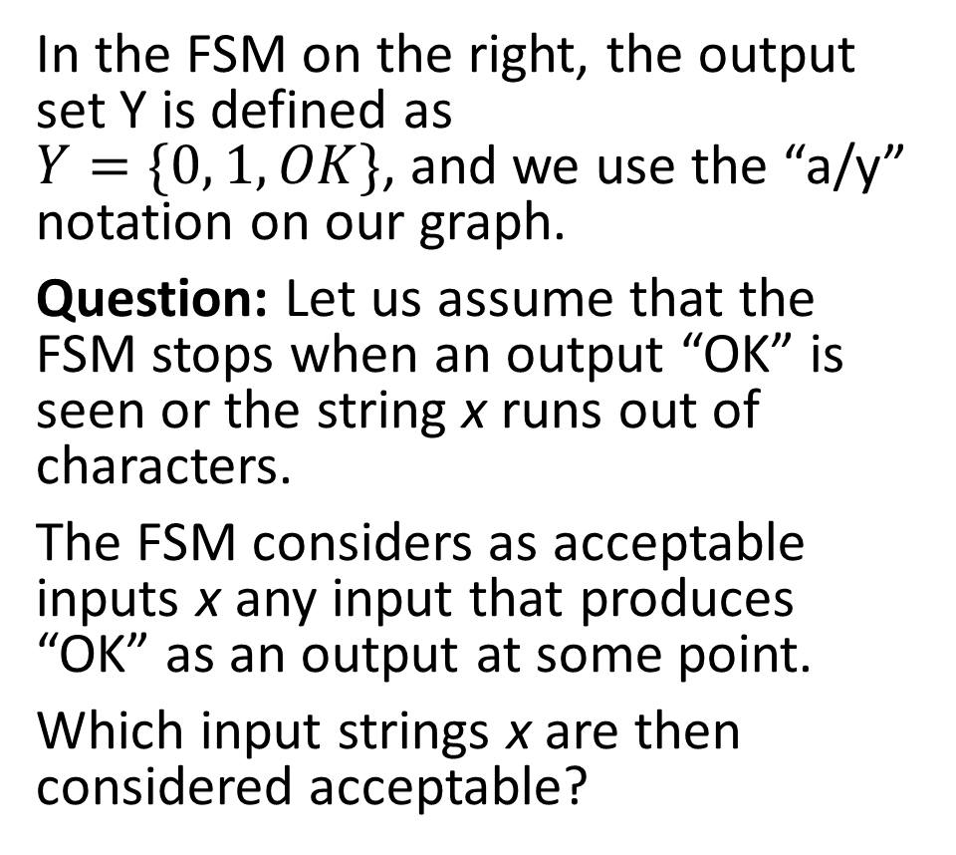
Practice 3
In the FSM on the right, the output set Y is defined as $Y=\{0, 1, OK\}$, and we use the “a/y” notation on our graph.
Question: Let us assume that the FSM stops when an output “OK” is seen or the string x runs out of characters.
The FSM considers as acceptable inputs x any input that produces “OK” as an output at some point.
Which input strings x are then considered acceptable?
Start
0/0
1/1
0/”OK”
1/1
0
1/1
1
0/0

Slide 38
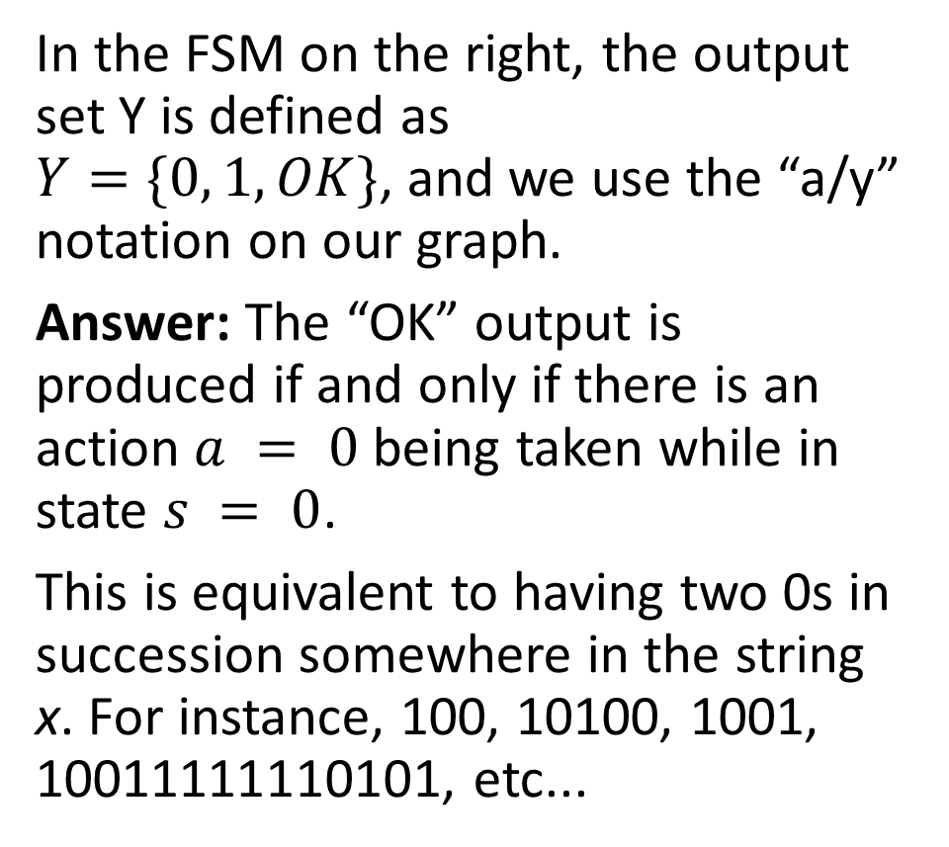
Practice 3
In the FSM on the right, the output set Y is defined as $Y=\{0, 1, OK\}$, and we use the “a/y” notation on our graph.
Answer: The “OK” output is produced if and only if there is an action $a = 0$ being taken while in state $s = 0$.
This is equivalent to having two 0s in succession somewhere in the string x. For instance, 100, 10100, 1001, 10011111110101, etc...
Start
0/0
1/1
0/”OK”
1/1
0
1/1
1
0/0

Slide 39
More advanced FSMs?
There are many variations to the state machines we have described.
For instance,
Deterministic Finite State Machines (DFSMs): A deterministic finite state machine is a mathematical model used to represent a system that has a finite number of states and can transition between those states based on input.
It is basically another name for the FSMs (with no outputs) we have been playing with.

Slide 40
More advanced FSMs?
There are many variations to the state machines we have described.
For instance,
Mealy Machines: A Mealy machine is a finite state machine where the output is dependent on both the current state and the input. That is basically another name for our FSM with outputs!
Moore Machines: A Moore machine is a finite state machine where the output is dependent only on the current state. A special case of the Mealy machine.

Slide 41
More advanced FSMs?
There are many variations to the state machines we have described.
For instance,
Non-Deterministic Finite State Machines (NDFSMs): In a non-deterministic finite state machine, the machine can transition from one state to multiple states based on the input.
This means that there can be multiple possible paths through the machine for a given input.

Slide 42
More advanced FSMs?
There are many variations to the state machines we have described.
For instance,
Stochastic Finite State Machines (SFSMs): A stochastic finite state machine is a model used to represent a system that has a finite number of states, but where the transitions have randomness aspects included.
In Stochastic Finite State Machines, there will be probabilities of transitioning between states.

Slide 43
Practice FSM
Let us consider this FSM, defined on the right.
We have seen that it considers as acceptable inputs the binary strings s whose bit of least importance is 0.
This means that the integer number input represented by the string s needs to be even to be acceptable.
Start
0
1
0
1
EVEN
1
ODD
0

Slide 44
Practice FSM
Let us try to implement this FSM in C now!
(A guided implementation, first.)
Start
0
1
0
1
EVEN
1
ODD
0

Slide 45
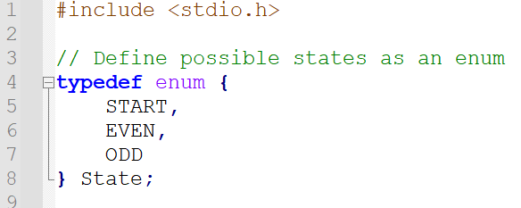
Coding a basic FSM step-by-step
First of all, we need to define:
A finite set of states S.
For convenience, we have decided to assemble all three possible states (START, EVEN, ODD) for our FSM into an enum.

Slide 46
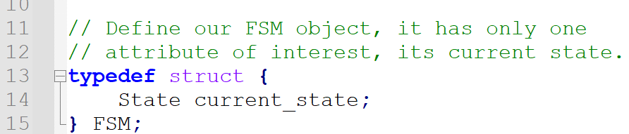
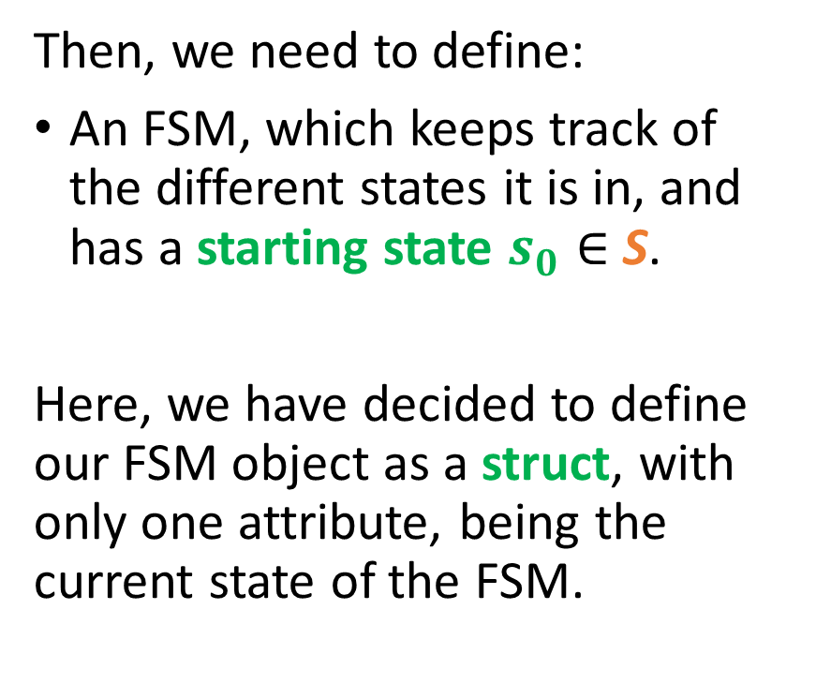
Coding a basic FSM step-by-step
Then, we need to define:
An FSM, which keeps track of the different states it is in, and has a starting state $s_{0}∈$S.
Here, we have decided to define our FSM object as a struct, with only one attribute, being the current state of the FSM.

Slide 47
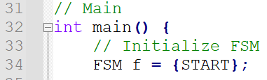
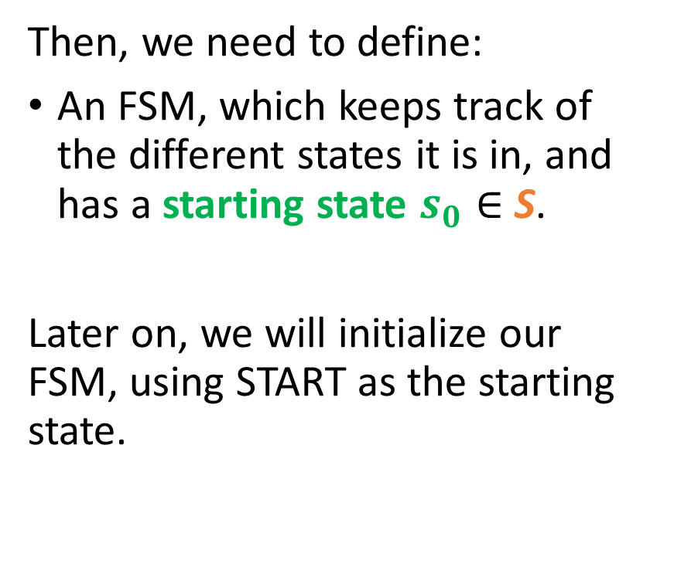
Coding a basic FSM step-by-step
Then, we need to define:
An FSM, which keeps track of the different states it is in, and has a starting state $s_{0}∈$S.
Later on, we will initialize our FSM, using START as the starting state.

Slide 48
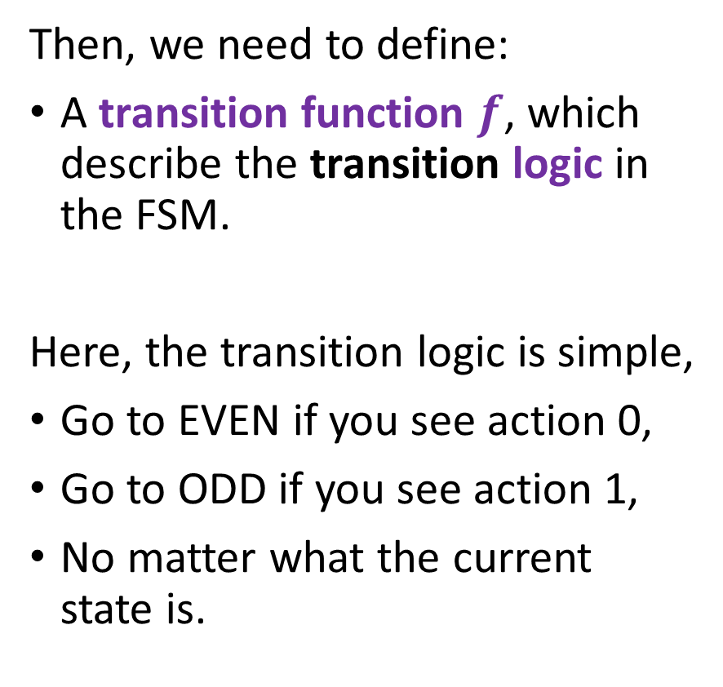
Coding a basic FSM step-by-step
Then, we need to define:
A transition function $f$, which describe the transition logic in the FSM.
Here, the transition logic is simple,
Go to EVEN if you see action 0,
Go to ODD if you see action 1,
No matter what the current state is.
Start
0
1
0
1
EVEN
1
ODD
0

Slide 49
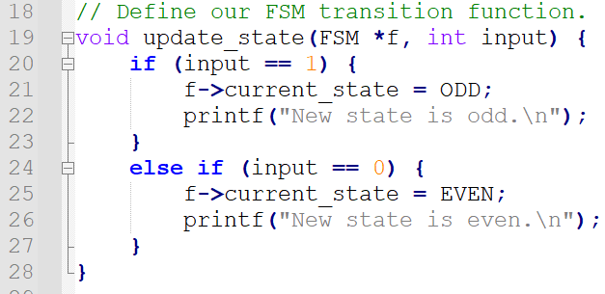
Coding a basic FSM step-by-step
We implement this logic using a simple if/else structure in an update function.
It takes our FSM,
It also takes our input character or action,
It then updates the current state attribute of our FSM struct, following the logic we have established.

Slide 50
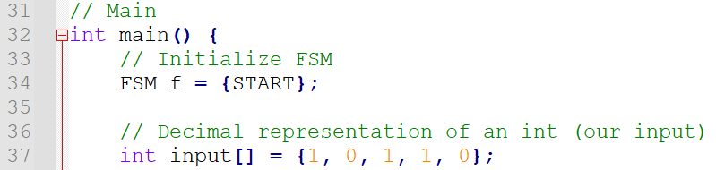
Coding a basic FSM step-by-step
We can then define our input string s in our main function for testing.
(Or we could ask the user for an input string using a scanf()…)

Slide 51
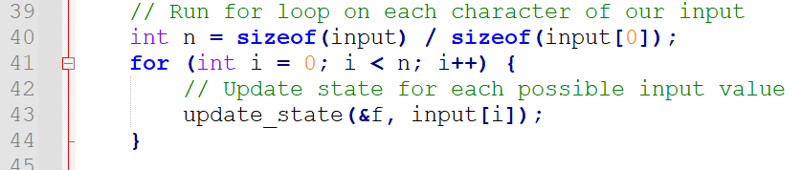
Coding a basic FSM step-by-step
We will then use a for loop for the appropriate amount of iterations n to browse through all the characters in the input string, one at a time, updating the state of our FSM every time.

Slide 52
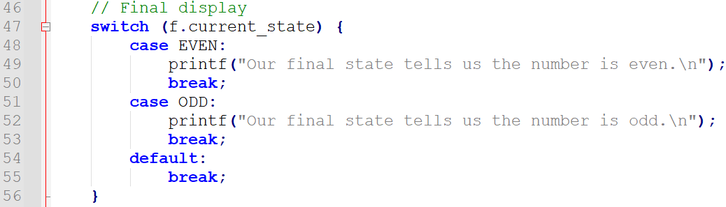
Coding a basic FSM step-by-step
Eventually, a final display showing a print corresponding to the final state (using a switch this time, because why not).

Slide 53
Using a transition table instead
In the previous implementation, we have used a transition, which implements the transition logic using an if/else statement.

Slide 54
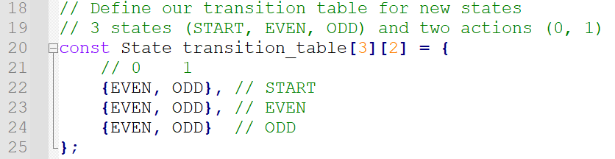
Using a transition table instead
Equivalently, we could have used a transition table as well.
Define it as a 3 by 2 table (with 3 possible states, 2 possible actions).

Slide 55
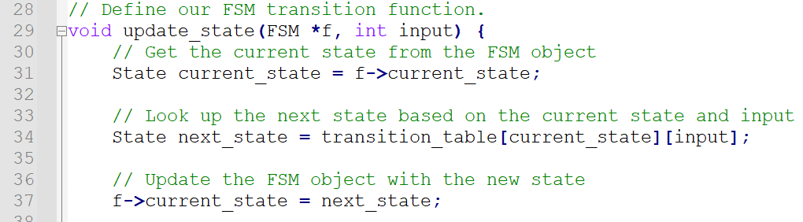
Using a transition table instead
Equivalently, we could have used a transition table as well.
Define it as a 3 by 2 table (with 3 possible states, 2 possible actions).
Use the transition table to find the next state directly.

Slide 56
Practice 4
Consider the FSM with a single stopping state, that considers as acceptable inputs any string x of 0 and 1, that have an even number of zeroes.
1
1
EVEN
0
ODD
0

Slide 57
Practice 4
Check the main.c file in the “3. Practice 4 template” folder.
Modify the code to implement this FSM !
(Solution is in folder 4., but no cheating…!)
1
1
EVEN
0
ODD
0

Slide 58
Conclusion
In this lecture,
A reminder on Finite State Machines, with and without outputs.
A guided implementation of FSMs without outputs.
(We leave the implementation of FSM with outputs as extra practice!)
Let us use the remaining time of today’s session to try and implement the FSMs in Practice Activities 1-4!

